Slide 1


What’s new in Azure Functions with .NET 6
Callon Campbell
Microsoft MVP | Azure
@flying_maverick

Slide 2


Speaker introduction
Callon Campbell
Solution Architect | Developer
Microsoft MVP | Azure
20 years enterprise development with Microsoft technologies – .NET (C#), Azure, ASP.NET, Desktop, SQL, and Mobile
Passionate about serverless and cloud-native application development
Blogging at https://TheFlyingMaverick.com
Speaker at community events and meetups
Co-creator of ReflectInsight, a live .NET log viewer
Organizer of “Canada’s Technology Triangle .NET User Group” in Kitchener, Ontario

Slide 3

Agenda
.NET 6 announcement
Azure Functions roadmap
Different hosting models
Breaking changes
Demos!
Wrap up
Q&A

Slide 4
.NET 6
Unified common base libraries & SDK
Industry leading performance
Simplified development, easier to get started
New C# 10, F# 6 releases
Apple Silicon (Arm64) support
Long-Term Support Release
get.dot.net/6

Slide 5


.NET 6 support in Azure today
Azure App Service Fully managed hosting for web apps,
REST APIs, and mobile back ends
All regions
Both Windows and Linux
Azure Static Web Apps
Streamlined full-stack development from
source code to global high availability
Blazor WebAssembly with AOT support
.NET 6 Azure Functions APIs
Azure Functions Event-driven serverless compute
Azure Functions runtime 4.0
Both in-process and isolated models
Notes:
Support for .NET 6 on Azure was day 0!
Azure App Service support for .NET 6 is available now in ALL regions, for BOTH Linux and Windows.
Azure Static Web Apps now supports full-stack .NET 6 apps with Blazor WebAssembly and Azure Functions.
Azure Functions support for .NET 6 is now available in Azure Functions runtime 4.0. Both the in-process and isolated models are supported in .NET 6.0 Azure Functions.

Slide 6
Run code when events occur
Event-driven scaling
No infrastructure management
Consumption pricing with free grant
Azure Functions
Notes:
Quick overview of Azure Functions
- Don’t have to worry about infrastructure, that’s handled for you.
- It will scale from not running to 1000s of instances and back down as needed.
- As it scales you only pay for what you use.

Slide 7
Azure Functions .NET Roadmap
In-process
.NET Core 3.1 ^{LTS}
Notes:
Azure Functions .NET 3.1 is an in process worker, so it depends on the host and the .NET version that it uses.

Slide 8
Azure Functions .NET Roadmap
.NET 5
Isolated process
In-process
.NET Core 3.1 ^{LTS}
Notes:
A .NET 5 function app runs in a new isolated worker process (from a .NET perspective)
- Decoupled .NET process from the host itself
- No worry on collisions from what the host is running
- Can support newer versions of .NET much faster this way
- Evolve the language worker and the host independently (which means new capabilities can be unlocked much faster)
Instead of building a .NET library loaded by our host, you build a .NET console app that references a worker SDK. This brings immediate benefits: you have full control over the application’s startup and the dependencies it consumes.
This new programming model also adds support for custom middleware which has been a frequently requested feature.

Slide 9
Azure Functions .NET Roadmap
.NET 5
.NET 6 ^{LTS}
Isolated process
.NET Conf 2021
In-process
.NET Core 3.1 ^{LTS}
.NET 6 ^{LTS}
Notes:
With the launch of .NET 6, .NET 6 functions now support both in-process and isolated models from day 1.

Slide 10
Azure Functions .NET Roadmap
.NET 5
.NET 6 ^{LTS}
.NET 7
.NET 8 ^{LTS}
Isolated process
2022
2023
In-process
.NET Core 3.1 ^{LTS}
.NET 6 ^{LTS}
Notes:
Long term, the vision is to have full feature parity out of process, bringing many of the features that are currently exclusive to the in-process model to the isolated model.

Slide 11
Azure Functions .NET Roadmap
.NET 5
.NET 6 ^{LTS}
.NET 7
.NET 8 ^{LTS}
Isolated process
2022
2023
In-process
.NET Core 3.1 ^{LTS}
.NET 6 ^{LTS}
Notes:
If using the in-process you can continue to use this for a while (will be supported)

Slide 12
Azure Functions .NET Roadmap
.NET 5
.NET 6 ^{LTS}
.NET 7
.NET 8 ^{LTS}
Isolated process
Nov 2021
In-process
.NET Core 3.1 ^{LTS}
.NET 6 ^{LTS}
with Durable Functions

Slide 13
Which one do I use?
In-process
Isolated process
Migrate from .NET Core 3.1 in-process
Need Durable Functions or “rich” SDK type bindings
Migrate from .NET 5 isolated process
Durable Functions coming to isolated process in 2022
Notes:
For .NET, Azure Functions supports both in-process and isolated (out-of-process) execution models. Choose in-process if you are upgrading from .NET Core 3.1 Azure Functions or if you are looking for features, such as Durable Functions, that are currently only available to in-process apps.
Isolated function apps provide more control of the function worker process and greater compatibility with libraries.

Slide 14
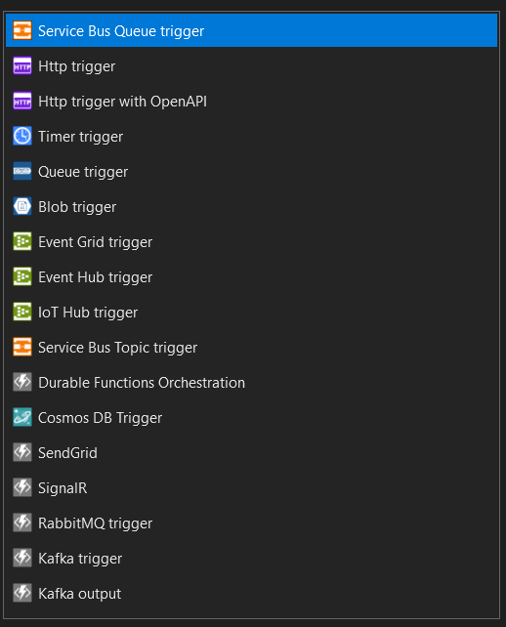
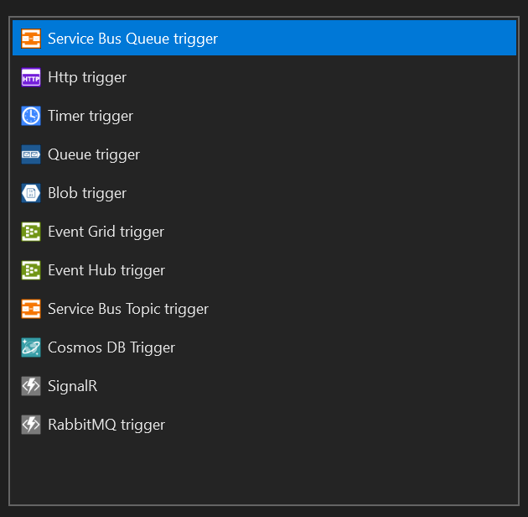
Available function types
.NET 6 In-process
.NET 6 Isolated

Slide 15
Breaking changes
Proxies are no longer supported in 4.x
Recommended to use Azure API Management
Logging to Azure Storage using AzureWebJobsDashboard is no longer supported in 4.x
Recommended to use Application Insights
Azure Functions 4.x enforces minimum version requirements for extensions
Upgrade to the latest version of affected extensions
Default and maximum timeouts are now enforced in 4.x Linux consumption function apps
Function apps that share storage accounts will fail to start if their computed hostnames are the same
Use a separate storage account for each function app
Remove HttpClient as a registered service
For a full list, see Azure Functions GitHub issues labeled Breaking Change: Approved

Slide 16
Deployment

Slide 17

Demos

Slide 18
Demo 1 notes
File new project, hello world
Show differences between in-process vs isolated:
Available function types / bindings
App settings (dotnet vs dotnet-isolated)
Highlight that VS 2022 is using Azurite

Slide 19
Demo 2 notes
Show how to migrate from .NET Core 3.1 to .NET 6 (in-process)
<TargetFramework>net6.0</TargetFramework>
<AzureFunctionsVersion>v4</AzureFunctionsVersion>
<PackageReference Include="Microsoft.NET.Sdk.Functions" Version="4.0.1" />

Slide 20
Demo 3 notes
Show how to migrate from .NET 5 to .NET 6 (isolated)
<TargetFramework>net6.0</TargetFramework>
<AzureFunctionsVersion>v4</AzureFunctionsVersion>
<PackageReference Include="Microsoft.Azure.Functions.Worker.Extensions.Http" Version="3.0.12" />
<PackageReference Include="Microsoft.Azure.Functions.Worker.Sdk" Version="1.3.0" OutputItemType="Analyzer" />
<PackageReference Include="Microsoft.Azure.Functions.Worker" Version="1.5.2" />

Slide 21
Demo 4 notes
Changes to Function App in the portal
Deployment to Azure

Slide 22

What we covered
Azure Functions v4 runtime
In-process vs isolated hosting models
Migrating to .NET 6
Breaking changes
Running .NET 6 in Azure

Slide 23
Related announcements
Updated SDKs
Blobs, Queues, Event Hubs, Event Grid, Service Bus
Support for Identity-based connections
Azure Functions OpenAPI Extension is now GA
Durable Functions with new backends (in preview)
SQL Server
Netherite

Slide 24

Further reading
Azure Functions 4.0 blog post aka.ms/Functions-V4-GA-Blog
Get started with .NET 6.0 on Azure Functions with this tutorial aka.ms/functions-v4-quickstart
Notes:
Call to action

Slide 25

Get started today!
Download .NET 6
Download Visual Studio 2022
Use the Upgrade Assistant
get.dot.net/6
VisualStudio.com/download
aka.ms/dotnet-upgrade-assistant

Slide 26





Let’s connect
Callon@CloudMavericks.ca
@flying_maverick
https://LinkedIn.com/in/CallonCampbell
https://GitHub.com/CallonCampbell

Slide 27

Thanks for joining!

Slide 28








Slide 29








Slide 30









Slide 31









Slide 32





Slide 33


Slide 34


Slide 37


